Slide 1
STOCK MARKET PREDICTION
Presented By:​
Tanu Milind​
Rupa Supriya​
Indranil Aditya​
Shreyash​
Mentor:​
K.S.Siri​

Slide 2
Business Problem: Estimate future stock prices based on historical data. Objectives: The main objective of this project is to understand the price of reliance stock data and predict the price of future.

Slide 3
Project Flow:
Data Collection: Data was acquired using the Yahoo Finance API through the ‘yfinance’ library for time series analysis.
Data Preprocessing: Preprocess the collected data to ensure it is accurate and formatted appropriately for time series analysis.
Feature Engineering: Scale features to a uniform range or standardize them to improve model performance.
Model Development: Developed predictive models to capture seasonal and trend components, while incorporating seasonal effects and exogenous variables for improved time series forecasting.
Model Deployment: Deployed the forecasting model for real-time stock price predictions, integrated with a user interface built in Streamlit for interactive data exploration and visualization.

Slide 4
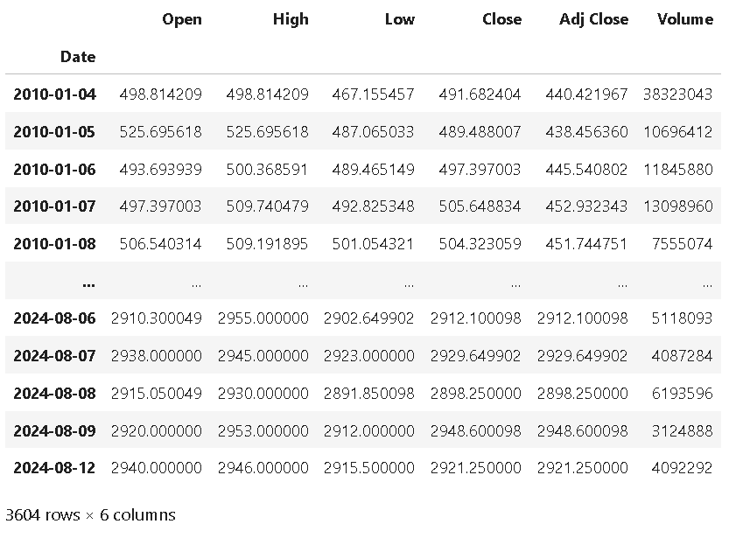
Data Set Details:

Slide 5
Description of Columns:-
Open:- It's the first price at which the stock is traded during the trading day.
Close:- It's considered one of the most important indicators of a stock's daily performance.
High:- It gives an idea of the maximum value reached by the stock during that day.
Low:- It indicates the minimum value that the stock reached during that day.
Volume:- It represents the level of activity and liquidity of the stock and is a crucial metric for traders and investors.

Slide 6
Exploratory Data Analysis
(EDA)

Slide 7
Missing Values:
The analysis indicates the absence of null values across all features. ​
Duplicate:​
After conducting necessary operations on our dataset, it has been verified that no duplicate values are present.​
Each observation is unique throughout the entire dataset.

Slide 8
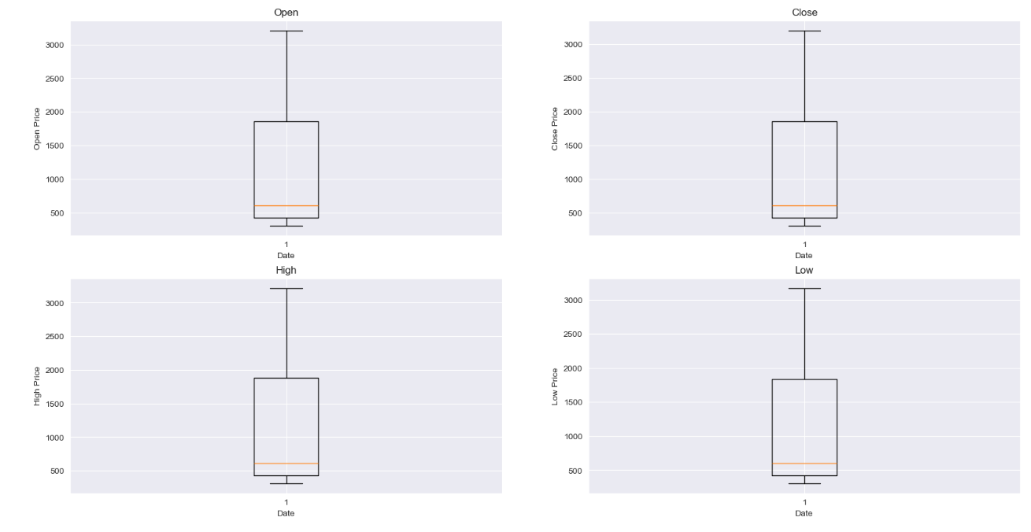
Outliers:
The attributes in our dataset does not exhibits outlier data points.​

Slide 9
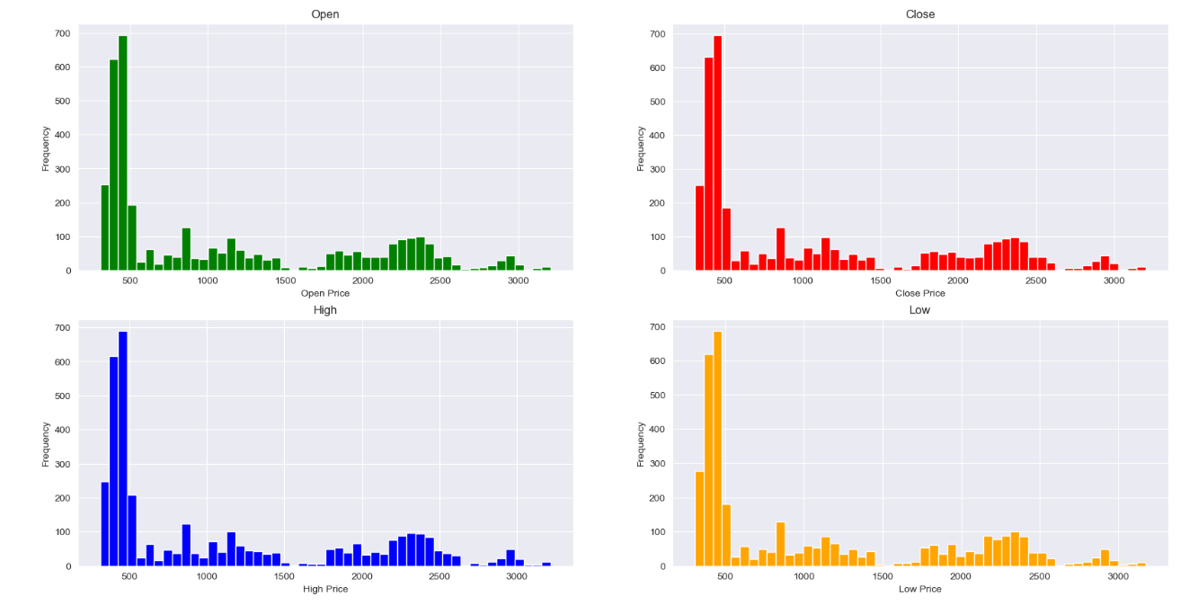
Visualization:
The histogram for the Open, Close, High, and Low attributes exhibits a right-skewed distribution.

Slide 10
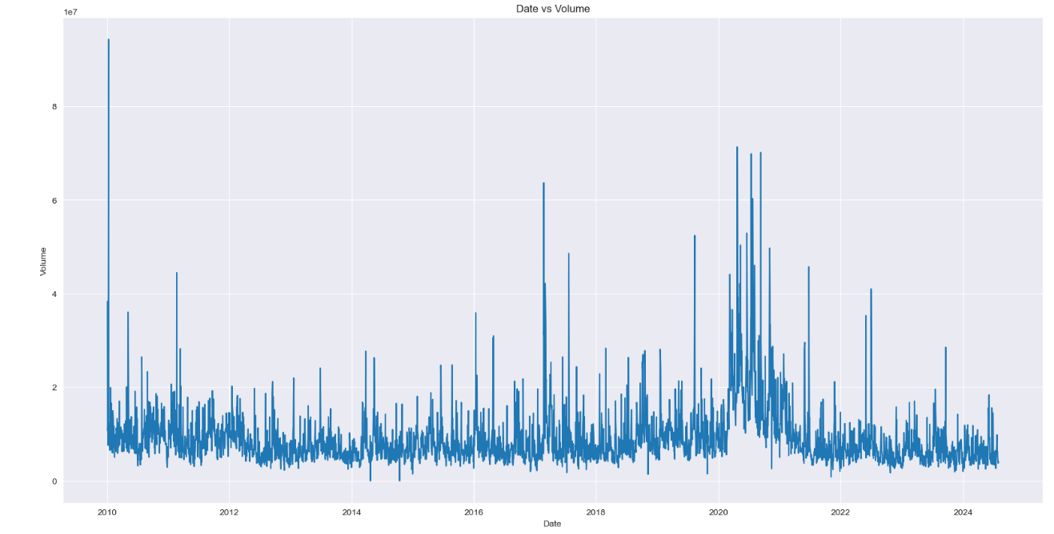
Line Chart:
The graph depicts trading volume over time from 2010 to 2024, highlighting significant fluctuations and spikes in activity, particularly noticeable around 2020 and 2021.

Slide 11
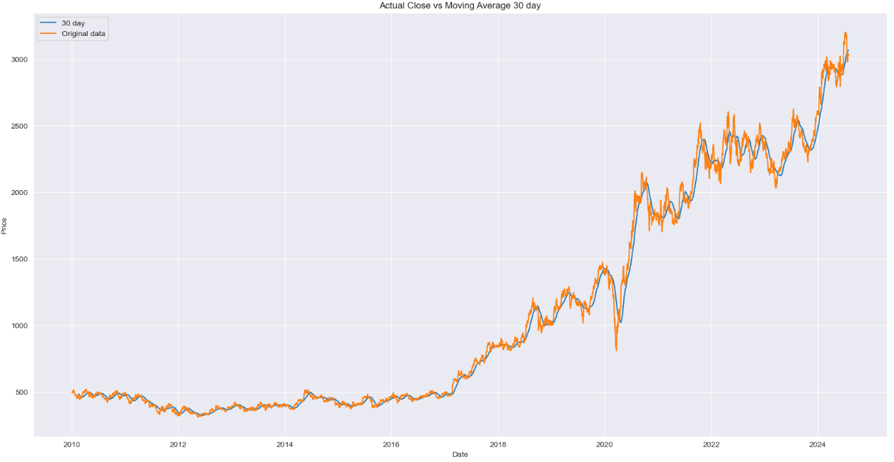
Moving Average 30 days:
The graph compares actual closing prices (orange) and a 30-day moving average (blue) from 2010 to 2024.
The 30-days moving average is less smooth and more sensitive to short-term fluctuations.
This analysis aids in identifying long-term trends and reducing noise.

Slide 12
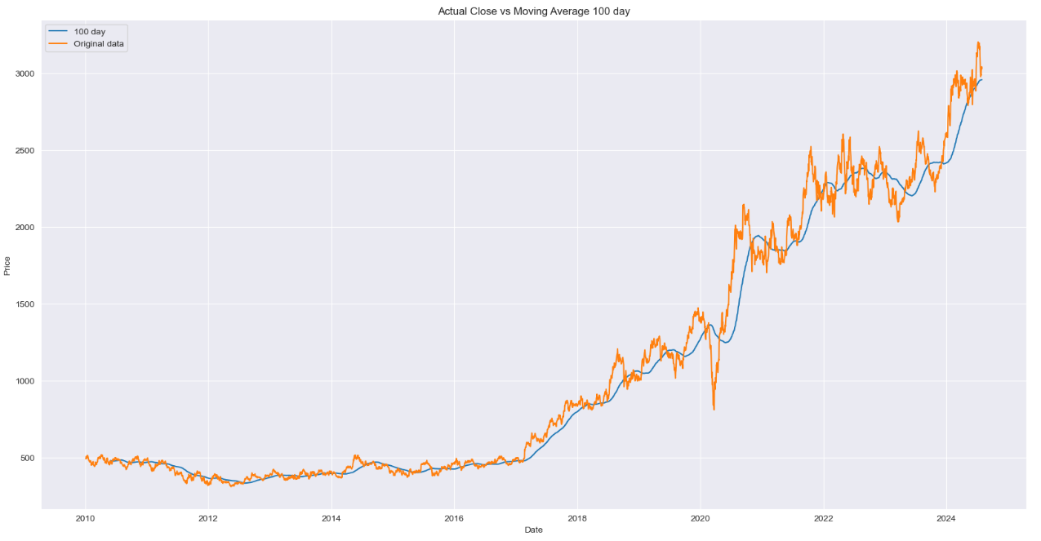
Moving Average 100 days:
The 100-day moving average is smoother and less sensitive to short-term fluctuations compared to the 30-day moving average.
It will better highlight long-term trends by filtering out more short-term noise.

Slide 13
Model Development:

Slide 14
Prophet:
The Close attribute was designated as the target variable.
The index was reset, and column names were changed: Date to 'ds' and Close to 'y’.
The Prophet Model was trained on the dataset.
Future dates were predicted for a period of 30 days.
Forecasts were generated for the same period.

Slide 15
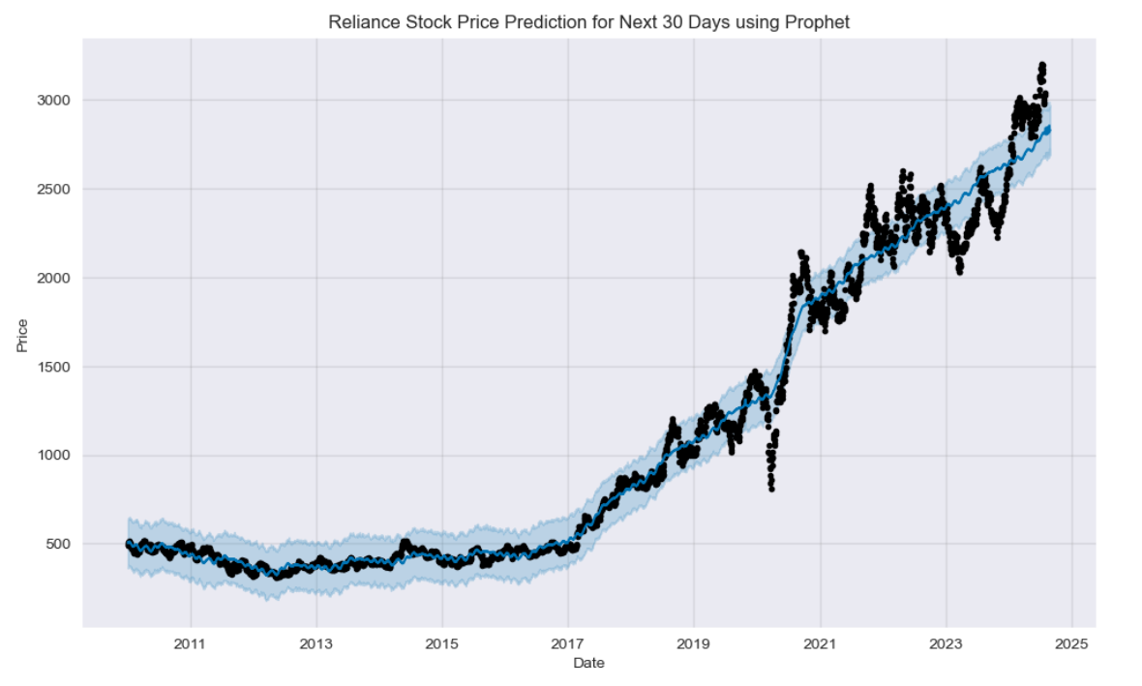
Prophet Graph:
The black scatter plot represents the actual observed data points.
The blue line plot indicates the model's predictions.
The blue region illustrates the upper and lower bounds of the forecasted values.

Slide 16
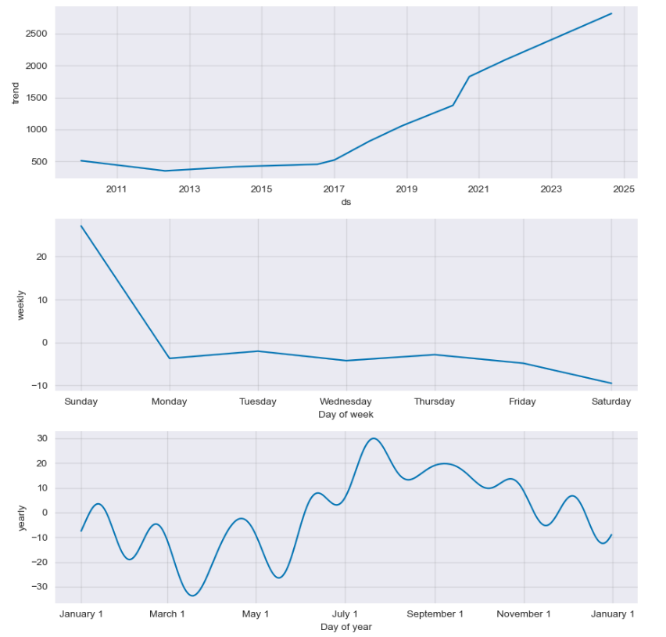
Components Graph:
The graph analyses the seasonality of the data.
The Prophet model accounts for both weekly and yearly seasonality components.

Slide 17
Cross Validation:
The Prophet model fitted to the dataset.
The duration of the initial training period, spanning from the beginning of the time series data to the first cutoff point.
The interval between cutoff dates, determining the frequency of model retraining and evaluation on new data subsets.
The forecast horizon, specifying the duration over which forecasts are generated from each cutoff point.

Slide 18
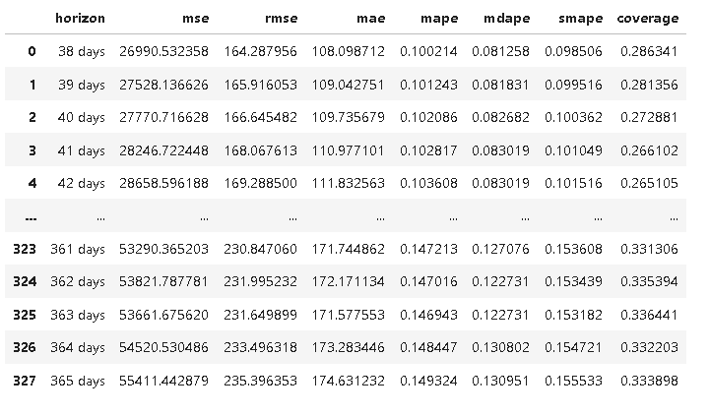
Performance Metrics:
The performance metrics were assessed, and the associated error for each metric was computed.

Slide 19
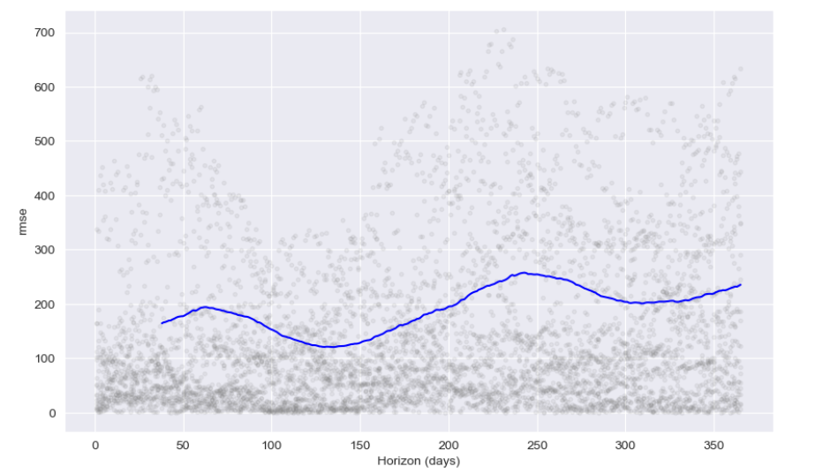
Cross Validation Chart:
This plot illustrates the trend of the error, specifically for RMSE.
The accuracy of Prophet model is notably high.

Slide 20
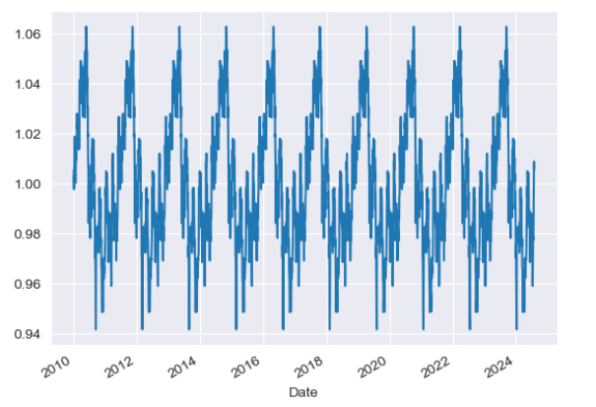
Checking Seasonality:
This time series plot displays data from 2010 to 2024, showing periodic fluctuations with a consistent annual pattern, indicating strong seasonality.
Values range between 0.94 and 1.06, oscillating around 1.00.

Slide 21
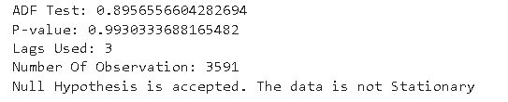
Dickey Fuller Test:
The Augmented Dickey-Fuller (ADF) test was conducted to evaluate the stationarity of the time series data.
The results of the test led to the rejection of the null hypothesis, indicating that the time series does not have a unit root and is, therefore, stationary.

Slide 22
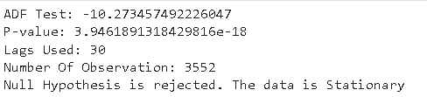
Differencing:
Differencing was performed on the target variable with a step size of 12.
The p-value was sufficiently low, indicating stationarity of the data making null hypothesis true.

Slide 23
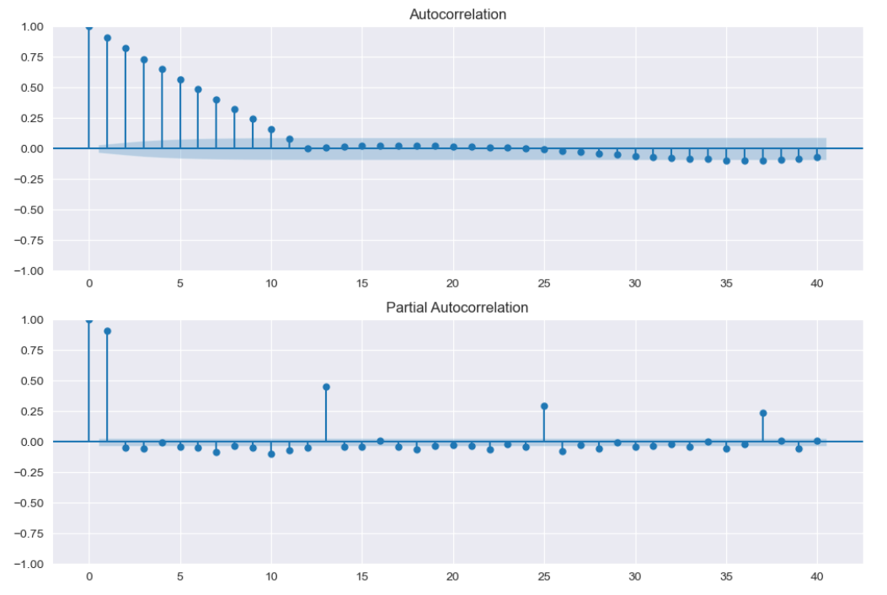
ACF and PACF Chart:
The ACF plot indicates the correlation between the time series and its lags, showing a gradual decline.
The PACF plot shows the direct correlation between the series and its lags, with significant spikes at specific lags.

Slide 24
SARIMAX:
The target column was selected for modelling.
The target column values were scaled for preprocessing.
The SARIMAX model was fitted to the dataset using specified parameters: (p, d, q) for the non-seasonal component and (P, D, Q, S) for the seasonal component.
A forecast horizon of 30 steps into the future was configured.
Forecast values were generated for the specified 30 future steps.
The forecasted values were transformed back to their original scale.

Slide 25
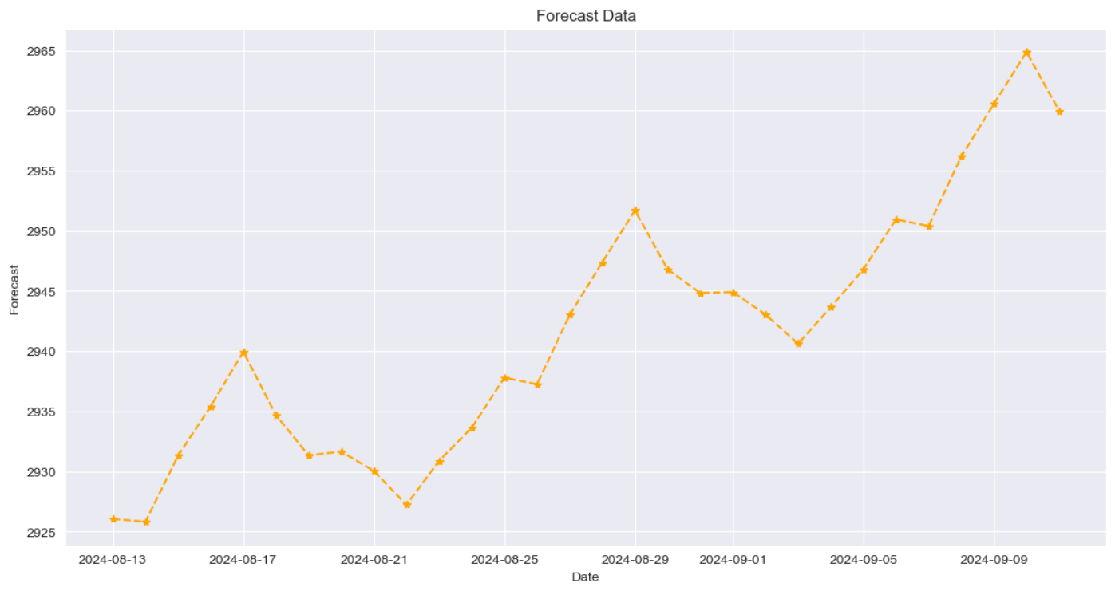
Sarimax Chart:
The provided chart illustrates forecasted data.
It shows a fluctuating trend, with the forecast values increasing from around 2925 to a peak just below 2965, followed by a slight decline.
The trend suggests a general upward movement with periodic dips.

Slide 26
Model Evaluation:

Slide 27
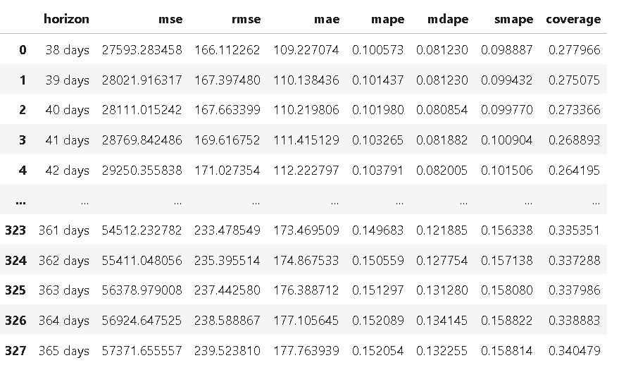
Prophet:
The error rate associated with the Prophet forecasting model is significantly elevated and considerably high.

Slide 28

SARIMAX:
The error rate associated with the SARIMAX forecasting model is significantly elevated and considerably low.

Slide 29
Model Deployment

Slide 30
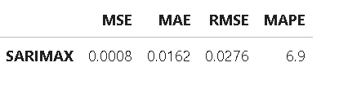
Model Selection:
Based on the analysis depicted in the error metrics, the SARIMAX model shows the lowest error rate compared to other model, it demonstrates superior performance, establishing it as the optimal choice for our model deployment phase.

Slide 31
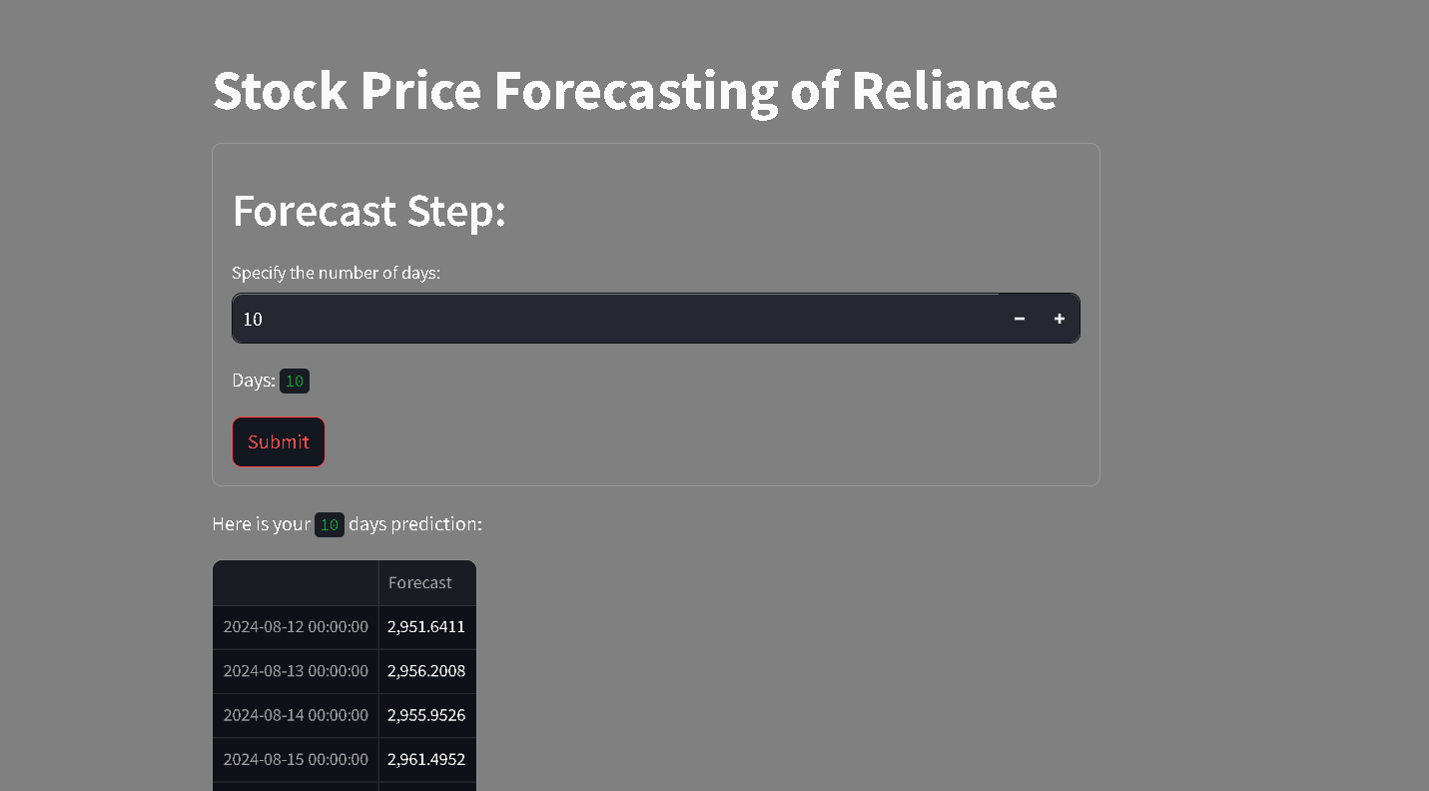
The Web Page:

Slide 32
Challenges:
Model selection was challenging due to the presence of seasonality in the data.
Encountered challenges in verifying stationarity due to non-stationary trends and seasonality in the data.
Numerous modifications were required in the deployment phase to obtain accurate forecast values.
Overcome:
Used autocorrelation plots and seasonal decomposition to identify model seasonality.
Applied the Dickey-Fuller test to detect stationary and used differencing techniques to transform non-stationary data into stationary.
Refined model parameters and updated forecasting logic based on real-time data feedback.

Slide 33

Summary:
Checked Null Values.
Checked Duplicate Values.
Checked Outliers.
Model Development.
Model Evaluation.
Model Deployment.

Slide 34
Thank You

